Slide 1













Mahindra & Mahindra: Leadership & Workforce Motivation
Leadership Style | Intrinsic Motivation | Values-Based Management

Slide 2











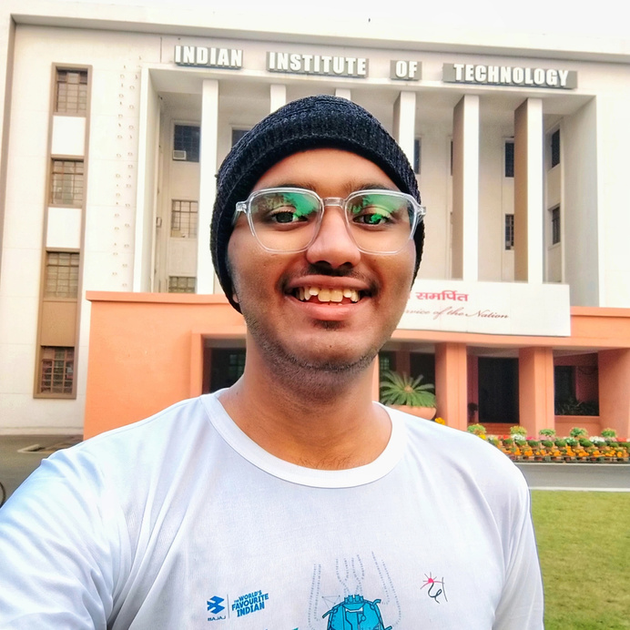





Members
BIKRAM SINGH
2302041046
TRISUL KUMAR PRADHAN
2302040002
NISHANT BARIK
2302041056
ABHIJIT RATH
2302040035
NARAYAN AGARWAL
2302041076
SAMUEL PRIYATAM DASH
2302040025
NANDU RAJIV U
2302040014
DINESH SAMAL
2403040002
SRINIBAS DAS
2302041066

Slide 3



GUIDED BY
MR. PRASANT BARLA
Assistant Professor
Department of Humanities

Slide 4
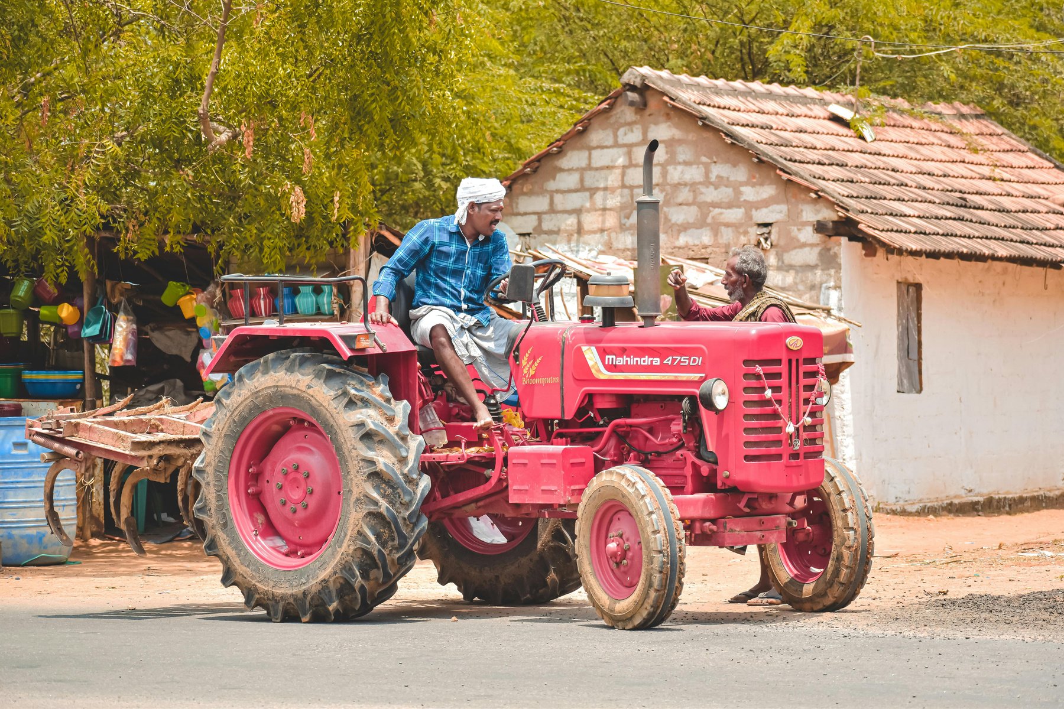
Mahindra & Mahindra: Leadership & Workforce Motivation
Welcome! Today, we delve into Mahindra & Mahindra, an Indian conglomerate that's mastered rural development, leadership, and workforce motivation. M&M is a multinational company based in Mumbai. Best known for tractors and SUVs, it also operates in aerospace, IT, agribusiness, and clean energy.
We'll explore how Mahindra's dedication to inclusive development and empowering rural India provides a perfect case study for understanding leadership's impact.

Slide 5


Vision, Mission, and Core Values
With a strong ethical base, M&M cultivates a culture that cares about people and performance, forming the backbone of leadership and rural engagement strategies.
Vision
Core Values
‘To be the most admired brand for its people, performance, and partnership.’ This aims for respect and trust from all stakeholders, not just profit.
•Professionalism
•Good corporate citizenship
•Customer-first focus
•Quality
•Dignity of the individual
Mission
‘Enable people to rise.’ It's about uplifting communities in rural India with tools, opportunities, and dignity.

Slide 6

01.
Transformational Leadership
Leadership Style at M&M
Leaders think innovatively and involve teams in decision-making. Leadership isn't confined to titles.
02.
Rise Philosophy
Individuals and communities drive positive change, supported by Mahindra’s leadership.
M&M’s culture promotes agility, collaboration, and empowerment. Leaders enable others to lead, especially in rural teams where local context is crucial.
03.
Adapts to Local Challenges
In rural areas, leadership becomes hands-on and empathetic, ensuring team members feel valued.

Slide 7
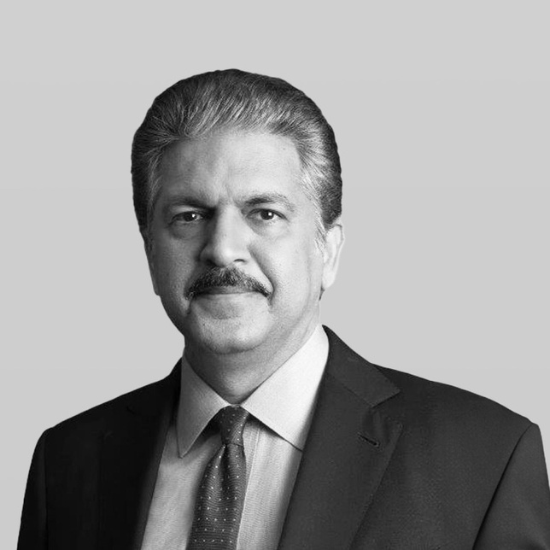

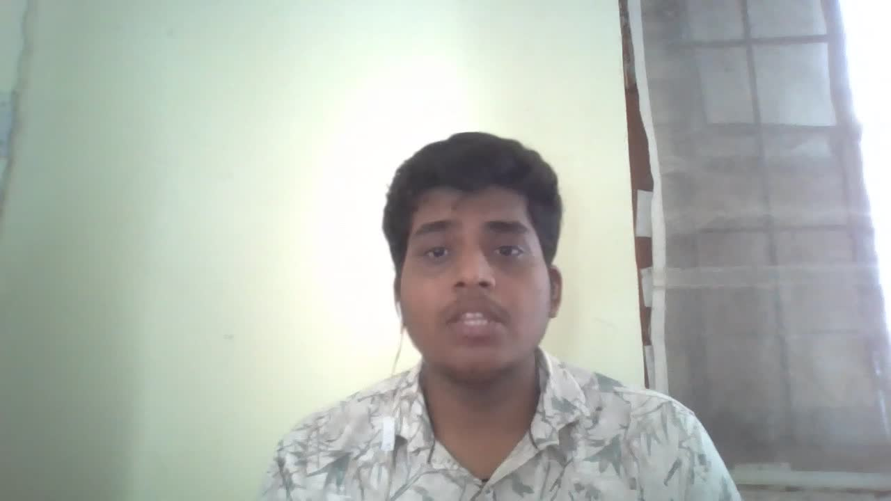
Anand Mahindra’s Role in Leadership
Anand Mahindra believes in purpose-driven leadership, digital transformation, and connection with customers, youth, and employees alike.
His leadership goes beyond boardrooms by building trust and encouraging innovation, motivating not just executives but the entire rural workforce.
Purpose-Driven
1
Links business success with social upliftment.
Digital Transformation
2
Encourages rural digitization and smart farming.
Connects with People
3
Builds trust, encourages innovation from the ground up, and leads with humility.

Slide 8

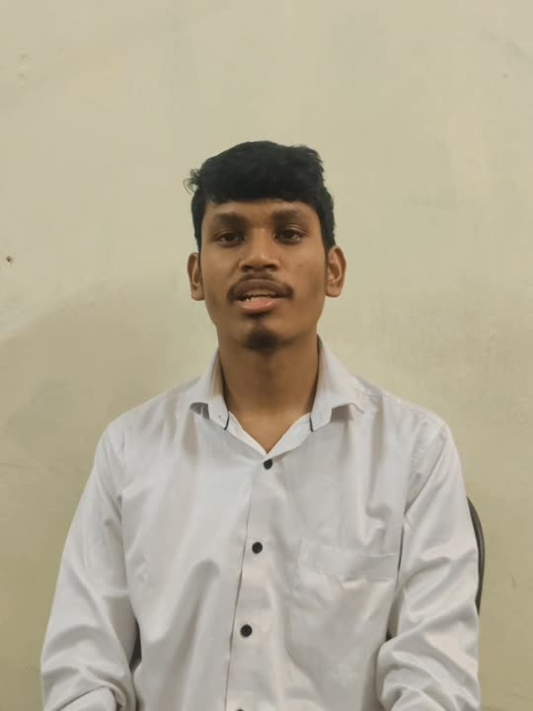
M&M’s Rural Market Focus
01
02
03
60% Revenue
Builds Relationships
Rural-Friendly Marketing
Over 60% of domestic revenue comes from rural markets due to tractors, small commercial vehicles, and equipment.
Mahindra builds relationships through rural dealerships, support centers, quick service, and financing.
From local festivals to farmer meets, Mahindra speaks the language of rural India—literally and culturally.

Slide 9
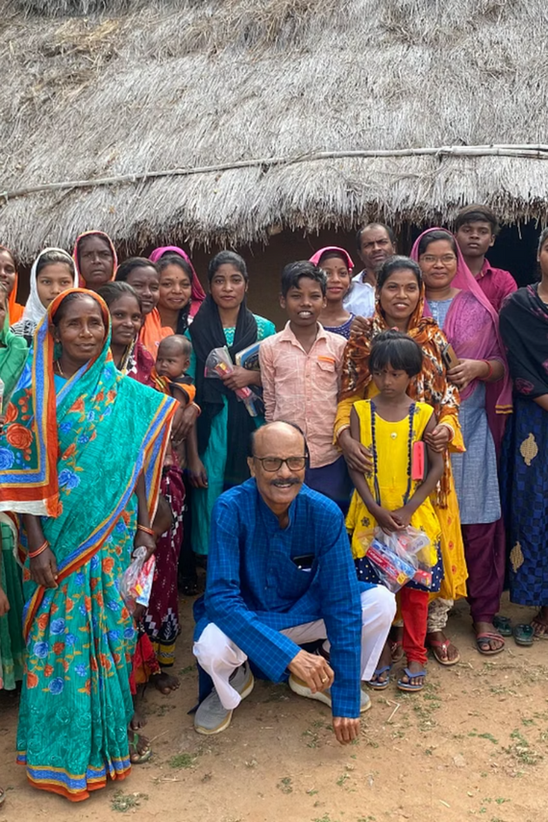


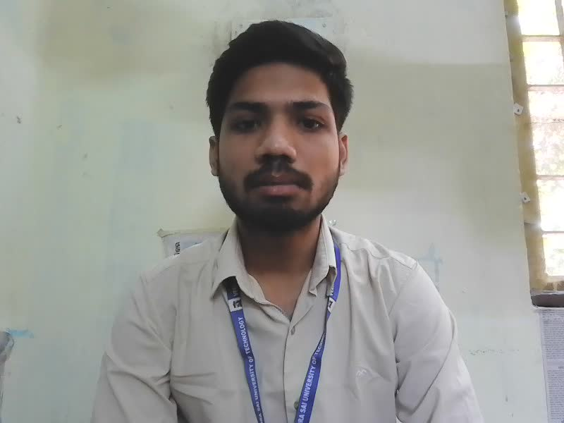
Challenges in Managing Rural Workforce
Language Barrier
Varying Education
Poor infrastructure
Managing a rural workforce presents unique challenges that Mahindra & Mahindra addresses head-on, including language barriers, varying education levels, and poor infrastructure.
Despite these challenges, Mahindra embraces differences with flexibility and empathy, creating a diverse and dedicated workforce.

Slide 10
Rural Workforce Motivation Strategies
01
Performance-based incentives
To keep rural employees motivated, Mahindra & Mahindra focuses on performance-based incentives, recognition, family support programs, and encouraging innovation.
Mahindra sees its rural workforce as partners in progress by implementing ‘Employee First’ programs that ensure well-being and growth opportunities.
02
Family support programs
03
Innovation encouraged

Slide 11
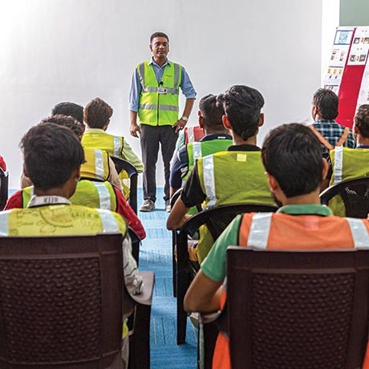

Training & Development Initiatives
Mahindra Pride School
Trains underprivileged youth in employable skills
Field-Specific Training
Mechanics trained in local languages using customized modules
Digital Literacy Programs
Workers use mobile tools for diagnostics, inventory, customer service
Mahindra invests heavily in training and developing its rural workforce through initiatives like the Mahindra Pride School and field-specific training.
By investing in upskilling, Mahindra improves productivity and fosters long-term loyalty among its rural employees.

Slide 12



Impact of Leadership and Motivation
Employee Retention
Customer Satisfaction
Increased Productivity
Enhanced Performance
Impact on Teamwork
These efforts—strong leadership, rural focus, training, and motivation—have led to a rise in employee retention, a drop in absenteeism, and better customer satisfaction.
Most importantly, the company's rural business has expanded significantly, proving that people-first leadership delivers results.

Slide 13


Conclusion and Learnings
Visionary Leadership
Combined with grassroots motivation uplifts business and society.
Motivation Beyond Salary
Includes dignity, recognition, and purpose.
Leadership Listens
Empowers, and invests in people; everyone rises.
Mahindra & Mahindra exemplifies how visionary leadership and grassroots motivation can uplift business and society.
Mahindra teaches us that when leadership listens, empowers, and invests in people—everyone rises, which is the true essence of sustainable success.

Slide 14

Thank you!

